Slide 1
Unit 4
File System and Storage Management

Slide 2
Introduction to File System
We usually require to store information for a long term.
Essential Requirements for long term information storage
1. Persistence : data stays around between jobs, power cycles, crashes
2. Speed : can get to data quickly
3. Size : can store lots of data
4. Sharing/Protection : users can share data where appropriate or keep it private when appropriate
5. Ease of use : user can easily find, examine, modify, etc. data
❖Solutions of above mentioned requirements is File System
❖System that provides the persistent storage of information arranged in some units (files) within the secondary memory is termed as File systems

Slide 3
Introduction to File System
Hardware Provides:
  Persistence: Disks provide non-volatile memory
  Speed: Speed gained through random access
  Size: Disks keep getting bigger (typical disk on a Personal Computer = 500GB - 1TB)
❖OS provides:
  Persistence: redundancy allows recovery from some additional failures
  Sharing/Protection: Unix provides read, write, execute privileges for files
  Ease of Use :
    Associating names with chunks of data (files) and Organize large collections of files into directories
    Transparent mapping of the user's concept of files and directories onto locations on disks
    Search facility in file systems

Slide 4
Files
File is a named collection of related information recorded on secondary storage
Files can contain programs (source, binary) or data
Files are an abstraction mechanism. They provide a way to store information on the disk and read it back later
File system shield the users from the details of how and where the information is stored, and how the disks actually work

Slide 5
File Attributes
Name – only information kept in human-readable form
Identifier – unique tag (number) identifies file within file system
Type – needed for systems that support different types
Location – This information is a pointer to a device and to the location of the file on that device
Size – current file size and possibly the maximum allowed size
Protection – Access-control information determines who can do reading, writing, executing
Time, date, and user identification – data for protection, security, and usage monitoring

Slide 6
File Attributes
The information about all files is kept in the directory structure, which also resides on secondary storage
Typically a directory entry consists of the file’s name and a unique identifier
The identifier in turn locates other file attributes

Slide 7
File Naming
When a process creates a file, it gives the file a name
When the process terminates, the file continues to exist and can be accessed by other processes using its name
Rules for naming a file varies from system to system
Normally strings of 1 to 8 characters are legal file names (digits & special characters also permitted). Many file systems support name as long as 255 characters
Some file systems distinguish between uppercase and lowercase letters (like UNIX) where as others don’t (like DOS)

Slide 8
File Naming : extension
A file is just a set of 1’s and 0’s
A “file type” is simply information associated with a file that tells the operating system and programs how to interpret these 1’s and 0’s
Many operating systems supports two-part file names; the part following the period is called the file extension and usually indicates something about the file
In UNIX, it is also possible to have two or more extension. For example homepage.html.zip where .html indicates a web page in HTML and .zip indicates that the file homepage.html has been compressed using a zip program
Some of the common file extensions include .bak, .c, .jpg, mp3, .zip, .txt etc

Slide 9
File Naming : extension
In Linux, usually, file extensions are just conventions and are not enforced in anyway by the OS
Linux does not always use extensions to identify file types
The operating system knows what files are without relying on the file extension
It does this using MIME (Multipurpose Internet Mail Extensions) types
Rather than relying on the file extension at the end of a file’s name, information about the file’s content — the file’s MIME type — is embedded into the beginning of the file itself
So, when you open a file with no file extension, Linux and Mac OS X will look at the file’s MIME type to determine what type of file it is

Slide 10
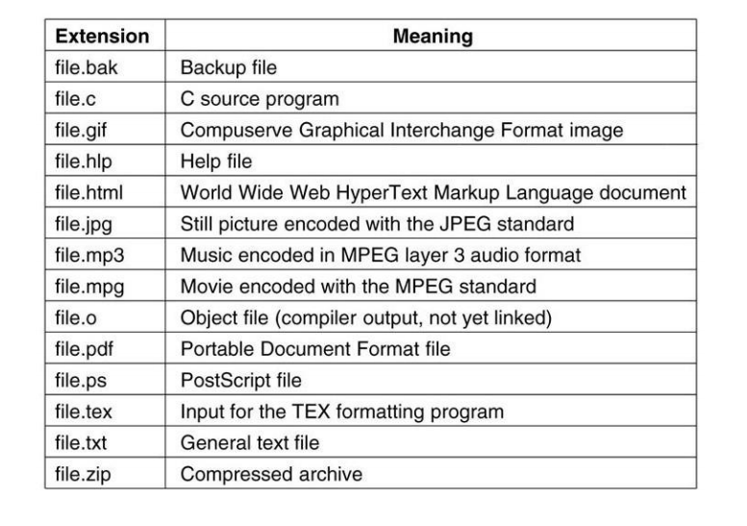
Some File extension and meaning in Windows

Slide 11
File Operations
create (name)
  Allocate disk space (check disk quotas, permissions, etc.)
  Create a file descriptor for the file including name, location on disk, and all file attributes.
  Add the file descriptor to the directory that contains the file.
delete(name)
  Find the directory containing the file.
  Free the disk blocks used by the file.
  Remove the file descriptor from the directory.

Slide 12
File Operations
close (file_ptr)
  Remove the entry for the file in the process's file table
  Decrement the open count in the system-wide file table
  If the open count == 0, remove the entry in the system-wide file table
read (file_ptr, from, size, bufAddress) - random access
  OS reads “size” bytes from file position “from” into “bufAddress”
read(file_ptr, size, bufAddress) - sequential access
  OS reads “size” bytes from current file position of file pointer, into “bufAddress” and increments current file position by size

Slide 13
File Operations
write() : name of the file
write is similar to read except it copies from buffer to file
seek() : just updates file pointer (fp)
append() : write only at the end of file
getAttributes() : Get information about the file
setAttributes() : Set the attributes of a file (eg. chmod in UNIX)
rename() : change the name of file

Slide 14
File Access Methods
Sequential Access Method
  It is the simplest access method.
  Information in the file is accessed in order, one record after another
  In sequential access, the OS read the file word by word.
  The file pointer is maintained which is updated after every read or write operation
  Sequential Access Method is reasonable for tape.
  In the sequential access method, if we use read command, then the pointer is moved ahead by 1.
  If the write command is used, then the memory will be allocated, and at the end of the file, a pointer will be moved.
  Advantage – The sequential access method is an easy implementation method for the software and hardware.
  Disadvantage – The sequential access takes a lot of time for performing the read-write operation.

Slide 15
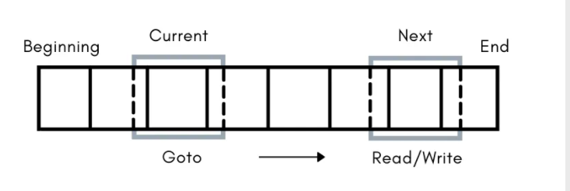
File Access Methods
Direct or Random Access Methods
  Allows access to any block in the file at any time
  Sometimes it is not necessary to process every record in a file. It is not necessary to process all the records in the order in which they are present in the memory.
  The direct access of a sequential file is not possible but Sequential access to a direct access file is possible.
  The Direct Access is mostly required in the case of database systems.

Slide 16
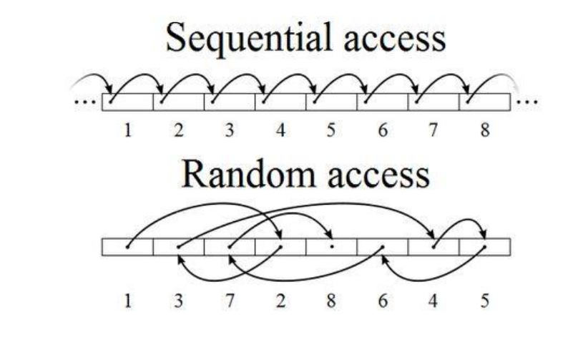
File Access Methods

Slide 17
File Access Methods
Indexed Access Method
  The Index Access method is an improvised version of the direct access method.
  In this method, an index is maintained which contains the address (or pointers) of the file blocks.
  So, to access any particular record of the file the operating system will first search its address in the index and the index will then point to the actual address of the particular block of the file that has the desired information.

Slide 18
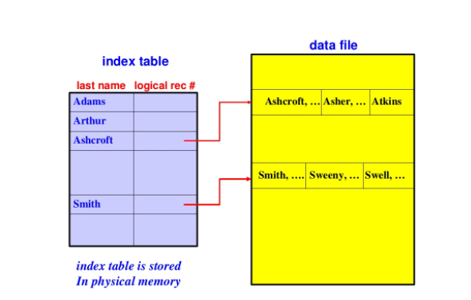
File Access Methods
Indexed Access Method

Slide 19
File Access Methods
Indexed Sequential Mode
  It is the other method of accessing a file that is built on the top of the sequential access method.
  These methods construct an index for the file.
  The index, like an index in the back of a book, contains the pointer to the various blocks.
  To find a record in the file, we first search the index, and then by the help of pointer we access the file directly.

Slide 20
Distributed File Systems (DFS)
A Distributed File System stores data across multiple machines but exposes it as a single logical file system.
The goals are:
  Transparency – Location, access, and replication are hidden from users
  Scalability – Handle growth in data and users
  Fault Tolerance – System survives node failures
  High Availability – Data accessible even during failures
  Performance – Parallel access and data locality

Slide 21
DFS DESIGN CHALLENGES
Transparency
  Location transparency
  Replication transparency
  Failure transparency
Naming and Metadata Management
  Centralized vs distributed metadata
  Namespace consistency
Consistency Models
  Strong consistency
  Eventual consistency
  Relaxed consistency
Fault Handling
  Disk failures
  Network partitions
  Node crashes
Security
  Authentication
  Authorization
  Encryption (data at rest and in transit)

Slide 22
DFS Architecture Models
Centralized Metadata Architecture
  Single metadata server
  Simpler design
  Potential bottleneck
  Examples:
    HDFS
    Google File System
Distributed Metadata Architecture
  Metadata spread across nodes
  High availability
  Complex synchronization
  Example:
    CephFS

Slide 23
Hadoop Distributed File System (HDFS)
Distributed file system to store data across a cluster of commodity machines
High emphasis on fault-tolerance
HDFS cluster is composed of a NameNode and various DataNodes

Slide 24
Hadoop Distributed File System (HDFS)
NameNode
  a server which holds all the metadata regarding the stored files
  manages incoming file system operations
  maps data blocks (parts of files) to DataNodes
DataNode
  handles file read and write requests
  create, delete and replicate data blocks amongst their disk drives
  continuously loop, asking the NameNode for instructions.
Note: size of 1 data block is typically 64 megabytes

Slide 25
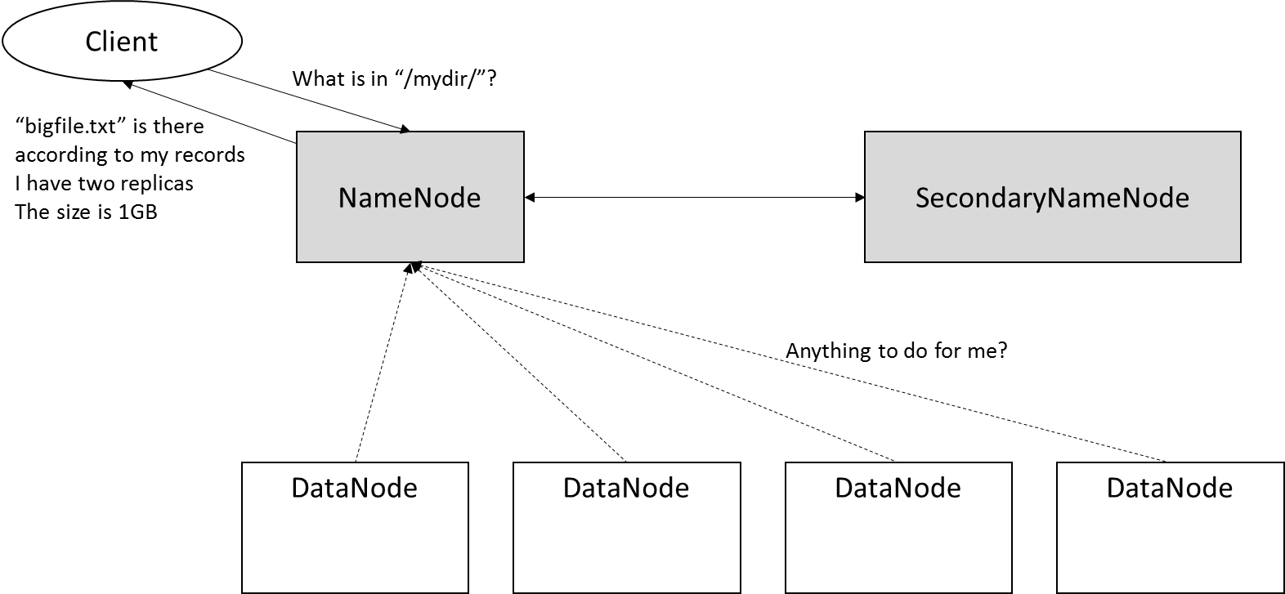
Hadoop Distributed File System (HDFS)

Slide 26
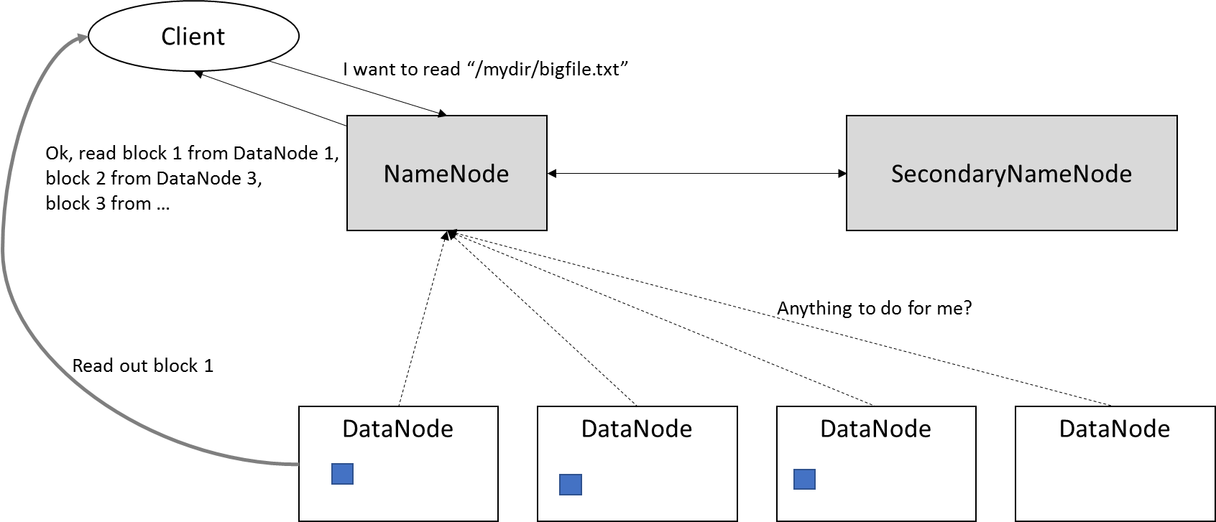
Hadoop Distributed File System (HDFS)

Slide 27
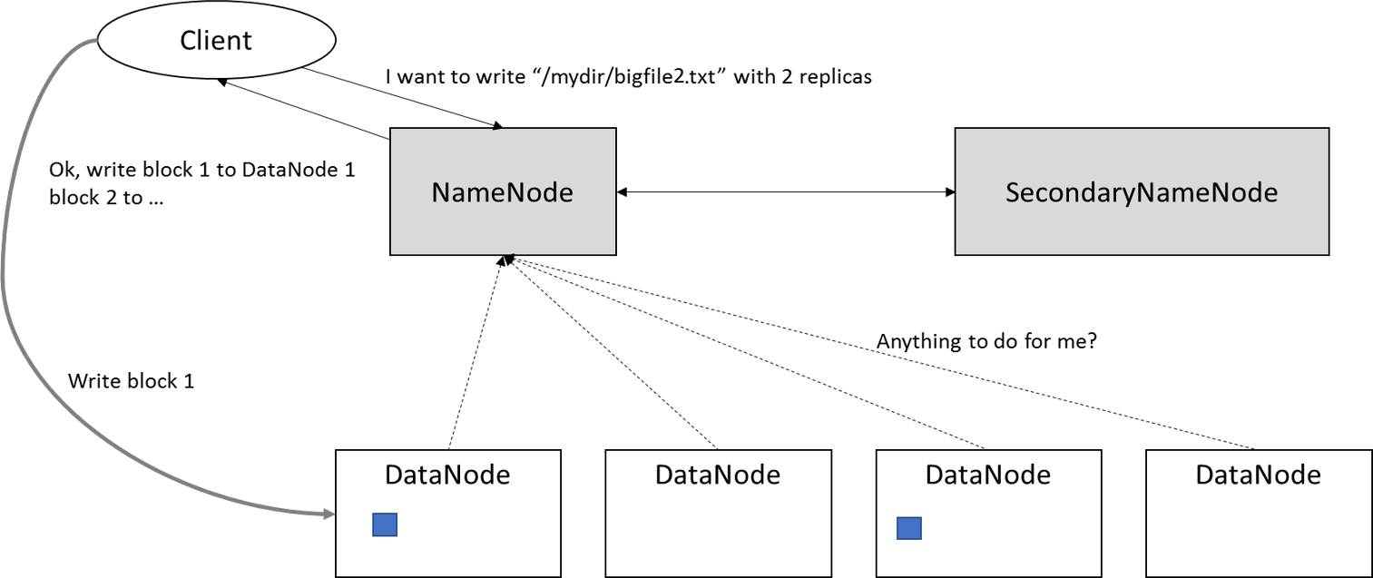
Hadoop Distributed File System (HDFS)

Slide 28
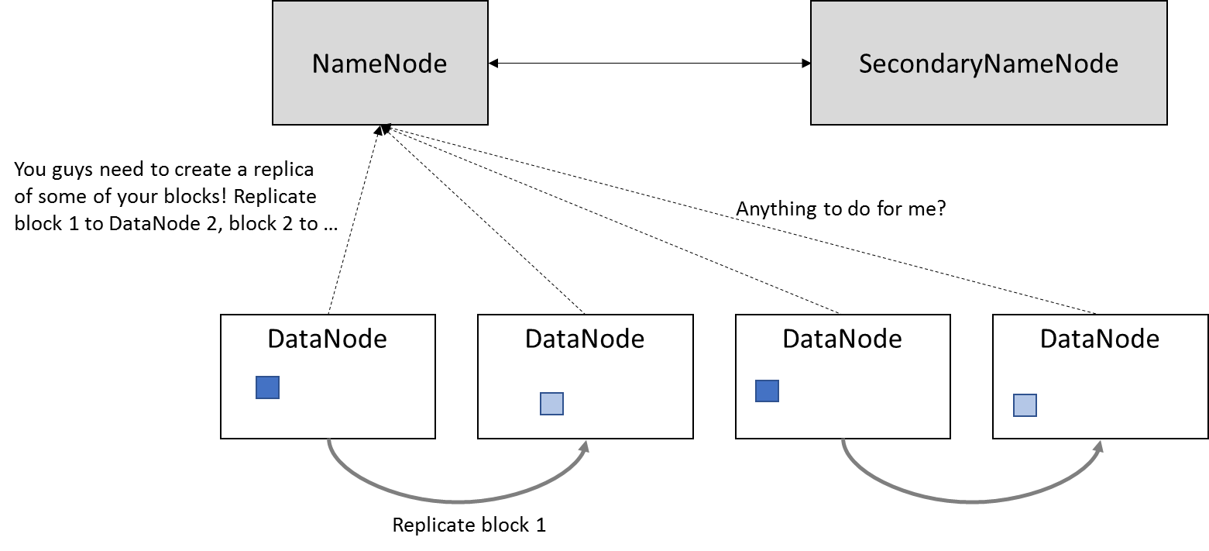
Hadoop Distributed File System (HDFS)

Slide 29
Hadoop Distributed File System (HDFS)
HDFS provides a native Java API to allow for writing Java programs that can interface with HDFS
String filePath = “/data/all_my_customers.csv”;
Configuration config = new Configuration();
org.apache.hadoop.fs.FileSystem hdfs = org.apache.hadoop.fs.FileSystem.get(config);
org.apache.hadoop.fs.Path path = new org.apache.hadoop.fs.Path(filePath);
org.apache.hadoop.fs.FSDataInputStream inputStream = hdfs.open(path);
byte[] received = new byte[inputStream.available()];
inputStream.readFully(received);

Slide 30
Hadoop Distributed File System (HDFS)
// ...
org.apache.hadoop.fs.FSDataInputStream inputStream = hdfs.open(path);
byte[] buffer=new byte[1024]; // Only handle 1KB at once
int bytesRead;
while ((bytesRead = in.read(buffer)) > 0) {
// Do something with the buffered block here
}

Slide 31
Hadoop Distributed File System (HDFS)
hadoop fs -mkdir mydir | Create a directory on HDFS
hadoop fs -ls | List files and directories on HDFS
hadoop fs -cat myfile | View a file’s content
hadoop fs -du | Check disk space usage on HDFS
hadoop fs -expunge | Empty trash on HDFS
hadoop fs -chgrp mygroup myfile | Change group membership of a file on HDFS
hadoop fs -chown myuser myfile | Change file ownership of a file on HDFS
hadoop fs -rm myfile | Delete a file on HDFS
hadoop fs -touchz myfile | Create an empty file on HDFS
hadoop fs -stat myfile | Check the status of a file (file size, owner, …)
hadoop fs -test -e myfile | Check if file exists on HDFS
hadoop fs -test -z myfile | Check if file is empty on HDFS
hadoop fs -test -d myfile | Check if myfile is a directory on HDFS

Slide 32
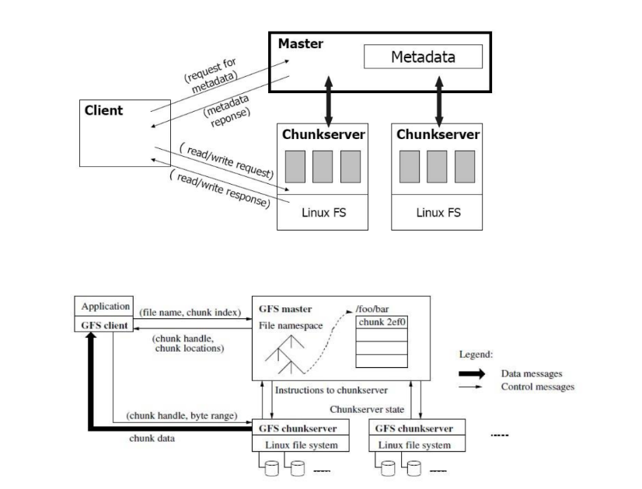
GOOGLE FILE SYSTEM
(GFS)

Slide 33
GOOGLE FILE SYSTEM
(GFS)
Overview
  GFS was designed to handle Google-scale workloads, assuming:
  Frequent hardware failures
  Append-heavy operations
  Massive datasets
Consistency Model
  Relaxed consistency
  Atomic append operations
  Prioritizes availability over strict consistency

Slide 34
GOOGLE FILE SYSTEM
(GFS)
Architecture Components
  Master
    Maintains metadata
    Manages chunk leases
    Controls replication
  Chunkservers
    Store data chunks (64 MB)
    Replicate chunks across nodes
  Clients
    Request metadata from Master
    Communicate directly with chunkservers

Slide 35
GOOGLE FILE SYSTEM
(GFS)
Design Assumptions
  Failures are common
  High bandwidth over low latency
  Large sequential reads/writes
Impact
  Inspired HDFS
  Influenced BigTable and MapReduce

Slide 36
Ceph
Ceph is a distributed storage system designed to store huge amounts of data safely and reliably by spreading it across many machines.
Think of Ceph as Google Drive for data centers, but:
  Self-managed
  Fault-tolerant
  Highly scalable
Ceph can provide:
  Object Storage
  Block Storage
  File System
All from one single storage backend.

Slide 37
Ceph
Why Ceph Exists
  Traditional storage systems:
    Fail if one server fails
    Don’t scale well
    Are expensive and rigid
Ceph assumes:
  Hardware WILL fail
  Disks WILL die
  Networks WILL break
So instead of avoiding failure, Ceph handles it automatically.

Slide 38
Ceph
Core Idea of Ceph
  “Store data as objects and distribute them intelligently so no single machine is critical.”

Slide 39
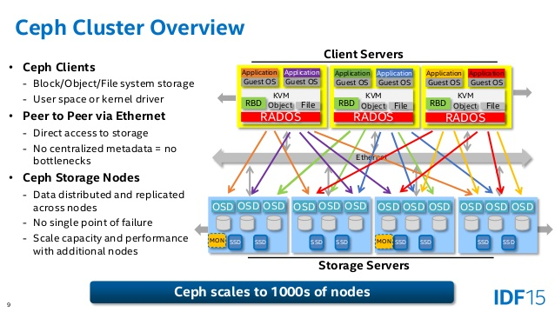
Ceph

Slide 40
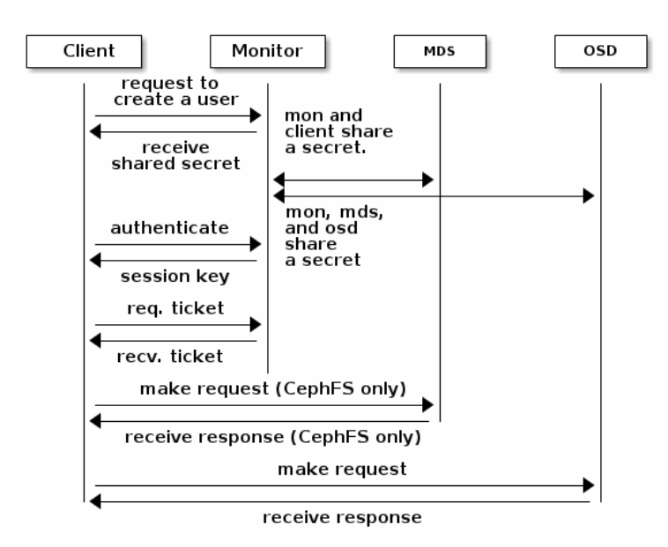
Ceph

Slide 41
Ceph
MON – Monitor
  Keeps track of who is alive
  Maintains cluster state
  Uses consensus (agreement between monitors)
  Without MONs, Ceph doesn’t know who to trust.
OSD – Object Storage Daemon (MOST IMPORTANT)
  Stores actual data
  Each disk usually runs one OSD
  Handles:
    Replication
    Recovery
    Rebalancing
If one disk fails → OSDs automatically copy data elsewhere.

Slide 42
Ceph
MDS – Metadata Server (Only for CephFS)
  Handles:
    File names
    Directories
    Permissions
  Does NOT store actual data
  Needed only when using Ceph as a file system.
How Ceph Stores Data
  Ceph uses an algorithm called CRUSH.
What CRUSH Does:
Decides where data should go
No central lookup table
Clients calculate data location themselves

Slide 43
Ceph
Data Replication in Ceph
  Default replication = 3 copies
  Copies stored on different disks and machines
  If one copy is lost → Ceph recreates it
  This gives:
    High availability
    Strong data safety
Consistency in Ceph
  Ceph provides strong consistency:
  When data is written, all clients see the updated data
  No stale reads (unlike some cloud storage systems)
  This is why Ceph is trusted for:
    Databases
    VM disks
    Critical workloads

Slide 44
Ceph
CephFS (Ceph as a File System)
  Features:
  POSIX compliant (works like Linux FS)
  Supports directories and permissions
  Multiple clients can access simultaneously
How It Works:
  Client contacts MDS for metadata
  Client reads/writes data directly to OSDs
  Metadata and data paths are separate, improving performance.

Slide 45
Ceph
Advantages of Ceph
  No single point of failure
  Highly scalable
  Self-healing
  Supports block, object, and file storage
  Open source
Disadvantages of Ceph
  Complex to set up
  Needs skilled administrators
  Higher resource usage
  Monitoring is critical

Slide 46
SSDs (Solid State Drives)
An SSD is a storage device that uses flash memory instead of spinning disks.
  No moving parts
  Much faster than HDD
  Non-volatile (data survives power loss)
Types of SSDs
Type Interface
SATA SSD SATA
NVMe SSD PCIe

Slide 47
SSDs (Solid State Drives)
Where SSDs Sit
  Used as secondary storage
  Block device (/dev/nvme0n1)
  OS sees it like a fast disk
Latency
~100 microseconds

Slide 48
Non Volatile Memory
NVM is a class of memory that:
  Is byte-addressable like RAM
  Is non-volatile like storage
This is where storage and memory start to merge.
Examples of NVM Technologies
  PCM (Phase Change Memory)
  ReRAM
  MRAM
  3D XPoint (used in Optane)
You don’t buy “NVM” as a product — it’s a technology category.

Slide 49
Persistent Memory
What is Persistent Memory?
Persistent Memory is NVM exposed directly on the memory bus (DDR).
The OS sees it as:
  RAM-like
  But data does not disappear on reboot
Classic example:
  Intel Optane Persistent Memory

Slide 50
Persistent Memory
Two Operating Modes
Memory Mode
  PMem acts as large RAM
  DRAM becomes cache
  Apps don’t see persistence
App Direct Mode
  Apps explicitly load/store persistent data
  Requires programming changes

Slide 51
Persistent memory in Modern Systems
CPU
├── DRAM (volatile, fastest)
├── Persistent Memory (PMem)
├── NVMe SSD
└── HDD
This new memory hierarchy is reshaping:
  Databases
  Distributed file systems
  Virtualization
  AI pipelines

Slide 52
ZFS (Zettabyte File System)
Developed by: Sun Microsystems (now Oracle)
Used in: FreeBSD, Solaris, TrueNAS, Linux (OpenZFS)
Key Features:
Copy-on-Write (CoW)
Built-in RAID (RAID-Z)
End-to-end checksumming (detects corruption)
Snapshots & cloning
Data compression & deduplication
Self-healing storage

Slide 53
ZFS (Zettabyte File System)
Copy-on-Write (CoW)
Traditional file systems overwrite data in place.
ZFS never overwrites existing data blocks.
Instead:
When data is modified
ZFS writes the modified data to a new block
Updates metadata to point to the new block
Only after everything is safely written → metadata pointer is switched
So the old data remains untouched until the new write is complete.

Slide 54
ZFS (Zettabyte File System)
Built-in RAID (RAID-Z)
ZFS doesn’t rely on hardware RAID.
It manages RAID at the file system level.
In RAID-Z:
Data is split into blocks
Parity information is calculated
Parity is distributed across disks
If one disk fails → data is reconstructed using parity
Unlike traditional RAID 5:
ZFS avoids the write hole problem because:
It uses Copy-on-Write
Parity and data are written atomically

Slide 55
ZFS (Zettabyte File System)
End-to-End Checksumming
When a block is written:
ZFS computes a checksum (hash)
That checksum is stored in the parent block (not in the same block)
Later, when reading:
ZFS recalculates checksum
Compares it with stored checksum
If mismatch → corruption detected

Slide 56
ZFS (Zettabyte File System)
Snapshots & Cloning
Because of Copy-on-Write:
Snapshot is just a metadata pointer freeze
No data is copied initially
Snapshot points to current blocks
When data changes:
New blocks are written
Snapshot still points to old block

Slide 57
ZFS (Zettabyte File System)
Data Compression & Deduplication
Before writing data:
ZFS compresses blocks (LZ4, gzip etc.)
Stores compressed version
Transparent to user
When writing data:
ZFS calculates hash of block
Checks if identical block already exists
If yes → just increases reference count
Does NOT store duplicate data

Slide 58
ZFS (Zettabyte File System)
Self-Healing Storage
This works because of:
RAID-Z or Mirror
Checksumming
When corrupted block is detected:
ZFS detects checksum mismatch
Reads same block from mirror/parity
Finds correct version
Rewrites corrupted block automatically

Slide 59
ZFS (Zettabyte File System)
Why it’s powerful:
ZFS treats storage like a storage pool, not separate partitions.
If a block gets corrupted → ZFS detects it using checksum → auto-repairs from mirror.
Downsides:
Heavy RAM usage (needs good memory)
Not native on Linux kernel (licensing issue)
Slightly complex
Best for: Enterprise storage, NAS, backups, critical data.

Slide 60
Btrfs (B-tree File System)
Developed by: Oracle
Used in: Linux (default in openSUSE, Fedora option)
Key Features:
Copy-on-Write
Snapshots
Subvolumes
Built-in RAID
Compression
Checksumming

Slide 61
Btrfs (B-tree File System)
Copy-on-Write (CoW)
Like ZFS, Btrfs never overwrites existing data.
When a file is modified:
The modified data is written to a new block
Metadata (stored in B-trees) is updated to point to the new block
Old block remains untouched
So writes are atomic — either fully completed or not applied at all.

Slide 62
Btrfs (B-tree File System)
Snapshots
Because of CoW:
A snapshot is just a new reference to existing metadata tree
No data is copied initially
It takes almost zero time
When changes happen:
New blocks are created
Snapshot still points to old blocks
So snapshot = cheap and instant backup
Example:
Take snapshot before system update → if update fails → roll back.

Slide 63
Btrfs (B-tree File System)
Subvolumes
This is a feature unique and very powerful in Btrfs.
What is a subvolume?
It’s like:
A separate logical filesystem
Inside the same partition
Each subvolume:
Has its own root
Can have its own snapshot
Can be mounted separately
How it works:
Btrfs organizes everything using B-trees.
A subvolume is basically a new tree root within the same filesystem.
So instead of partitioning disk:
You create logical containers.
Very flexible.

Slide 64
Btrfs (B-tree File System)
Built-in RAID
Btrfs can manage multiple disks itself.
Supported RAID types:
RAID 0
RAID 1
RAID 10
RAID 5/6 (still risky)
How it works:
Data and metadata are distributed across disks.
Parity or mirroring is handled at filesystem level.
Difference from hardware RAID:
Managed directly by Linux kernel
Can add/remove disks dynamically
RAID 5/6 still not considered fully stable.

Slide 65
Btrfs (B-tree File System)
Compression
Before writing data:
Btrfs compresses blocks (zlib, lzo, zstd)
Stores compressed version
Benefits:
Saves space
Improves read/write performance (less disk I/O)
Compression is transparent — user doesn’t notice.

Slide 66
Btrfs (B-tree File System)
Checksumming
Every data and metadata block:
Gets a checksum calculated
Stored separately in metadata tree
During read:
Checksum is recalculated
Compared with stored checksum
If mismatch → corruption detected
If redundancy (RAID/mirror) exists:
It fetches correct copy
Repairs bad block
This protects against silent corruption.

Slide 67
Btrfs (B-tree File System)
Quick Conceptual View
  Btrfs internally uses:
  B-tree structures
  Copy-on-Write everywhere
  Logical volume management built-in
  So it combines:
  File system + Volume manager in one.

Slide 68
Btrfs (B-tree File System)
Difference from ZFS:
Think of Btrfs as Linux’s answer to ZFS — but lighter.
Pros:
Integrated into Linux kernel
Easier to manage
Good for desktops and servers
Cons:
RAID 5/6 still considered unstable in some cases
Not as mature as ZFS in enterprise use
Best for: Linux desktops, dev machines, snapshot-based systems.

Slide 69
EXT4
Developed for: Linux
Most widely used Linux file system
Key Features:
Journaling
Large file & volume support
Stable & mature
Low overhead

Slide 70
EXT4
Journaling
Before modifying actual data on disk:
EXT4 writes the change information into a journal (log area)
Once journal write is successful
It performs the actual change to the filesystem
Marks journal entry as complete
If system crashes:
On reboot, EXT4 checks journal
Replays unfinished operations
Restores consistency

Slide 71
EXT4
Large File & Volume Support
EXT4 improved limits of EXT3.
Technical improvements:
Uses 64-bit block numbers
Supports:
  Up to 1 EB filesystem (theoretical)
  Very large individual files (up to 16 TB typical depending on block size)
How?
EXT4 uses:
Extents instead of block mapping
Old EXT3:
Stored list of individual blocks (inefficient for large files)
EXT4:
Stores a range of contiguous blocks as one extent
Example:
Instead of storing 1000 block entries → store 1 extent entry.

Slide 72
EXT4
Stable & Mature
This isn’t marketing — it’s architectural simplicity.
EXT4:
Has been tested for years
Used in almost every Linux distro
Minimal experimental features
Why stable?
Because:
No aggressive CoW everywhere
No complex volume management
Traditional in-place updates
Well-tested journaling system
It prioritizes reliability over innovation.

Slide 73
EXT4
Low Overhead
Compared to ZFS/Btrfs:
No checksumming for every block
No built-in RAID calculations
No dedup hash tables
No constant tree rewriting (like CoW systems)
So:
Lower CPU usage
Lower RAM usage
Less fragmentation
Good for small systems
That’s why EXT4 runs beautifully even on low-resource machines.

Slide 74
EXT4
Why it’s popular:
Because it’s:
Fast
Stable
Simple
Very well-tested
Limitations:
No built-in snapshots
No native checksumming like ZFS
No built-in RAID
Best for: General-purpose Linux systems.
If you want reliability without complexity → EXT4.

Slide 75
APFS (Apple File System)
Developed by: Apple
Used in: macOS, iOS, iPadOS
Key Features:
Copy-on-Write
Snapshots
Strong encryption (multi-key encryption)
Optimized for SSD
Space sharing between volumes
Special Focus:
Designed mainly for SSDs and flash storage.

Slide 76
APFS (Apple File System)
Copy-on-Write (CoW)
APFS never overwrites metadata directly.
When metadata changes:
It writes the modified metadata to a new block
Updates pointers
Switches to new structure atomically
Old blocks remain untouched until new write completes.
Why Apple uses this:
Prevents corruption during crashes
Enables instant snapshots
Makes filesystem consistent without fsck
Important:
APFS mainly applies CoW to metadata, not aggressively to all file data like ZFS.
That reduces fragmentation.

Slide 77
APFS (Apple File System)
Snapshots
Because of CoW:
Snapshot = frozen reference to current filesystem state
No full copy is made
Takes almost zero time
When changes happen:
New blocks are written
Snapshot still points to original blocks
macOS uses this for:
Time Machine backups
System updates rollback
Very efficient and space-saving.

Slide 78
APFS (Apple File System)
Strong Encryption (Multi-Key Encryption)
This is where APFS shines.
APFS supports:
Per-volume encryption
Per-file encryption
Multiple encryption keys
There are typically:
One key for metadata
One key per file
So if one file key is compromised:
→ Entire disk is not compromised.
Encryption uses:
AES-XTS
Hardware acceleration (Apple Silicon)
This makes iPhones and Macs extremely secure by default.

Slide 79
APFS (Apple File System)
Optimized for SSD
APFS was built specifically for flash storage.
How?
No traditional block rewriting pattern
Minimizes write amplification
Uses TRIM support
Fast directory sizing
Efficient space allocation
Unlike older HFS+, which was HDD-focused.
APFS avoids unnecessary disk seeks (important for SSD longevity).

Slide 80
APFS (Apple File System)
Space Sharing Between Volumes
This is very clever.
Traditional systems:
You divide disk into fixed partitions
Each partition has fixed size
APFS:
Creates a container
Inside container → multiple volumes
All volumes share same free space dynamically
Example:
You create:
macOS volume
Data volume
Backup volume
You don’t assign fixed sizes.
They grow and shrink automatically based on usage.
This avoids wasted space.

Slide 81
APFS (Apple File System)
Pros:
Fast metadata operations
Strong encryption
Native macOS integration
Cons:
Not open-source
Limited cross-platform support
Best for: Apple ecosystem devices.

Slide 82
Scalability and Consistency Challenges in File and Storage Systems
Modern storage systems must handle massive data growth while ensuring reliability, performance, and consistency. However, achieving scalability and maintaining consistency simultaneously remains a significant challenge.
1. Scalability Challenges
Scalability refers to the system’s ability to handle increasing amounts of data, users, and workloads without performance degradation.
a) Data Volume Explosion
With cloud computing, IoT, AI, and big data applications, storage systems must manage petabytes to exabytes of data. Traditional centralized file systems struggle to scale efficiently.
b) Distributed Storage Complexity
Modern systems (e.g., HDFS, Ceph, Amazon S3) distribute data across multiple nodes. Challenges include:
Data partitioning and replication management
Network latency
Node failures and fault tolerance
c) Metadata Bottlenecks
In distributed file systems, metadata servers can become bottlenecks when handling millions of file operations per second.
d) Performance vs. Cost Trade-offs
Scaling storage horizontally increases infrastructure cost, energy consumption, and management complexity.

Slide 83
Scalability and Consistency Challenges in File and Storage Systems
2. Consistency Challenges
Consistency ensures that all users see the same version of data at the same time.
a) CAP Theorem Limitation
According to the CAP theorem, a distributed system can guarantee only two of the following:
Consistency
Availability
Partition Tolerance
Most large-scale systems prioritize availability and partition tolerance, sacrificing strong consistency (eventual consistency model).
b) Replication Issues
Data replication improves availability but creates synchronization challenges:
Stale reads
Write conflicts
Replica divergence
c) Concurrency Control
Simultaneous read/write operations require mechanisms such as:
Locking
Versioning
Consensus algorithms (e.g., Paxos, Raft)
d) Latency Impact
Stronger consistency models increase latency due to coordination between distributed nodes.

Slide 84
Scalability and Consistency Challenges in File and Storage Systems
3. Balancing Scalability and Consistency
Modern systems adopt hybrid approaches:
Eventual consistency (e.g., NoSQL systems)
Tunable consistency models
Distributed consensus protocols
Sharding with replication
The challenge lies in designing systems that scale globally while maintaining acceptable levels of consistency and performance.

Slide 85
Case Studies: Emerging Storage Technologies
1. DNA Storage
Overview
DNA storage encodes digital data into synthetic DNA sequences.
How It Works
Binary data → Converted into nucleotide sequences (A, T, C, G) → Synthesized into DNA strands → Stored → Sequenced to retrieve data.
Advantages
Extremely high storage density (1 gram can store ~215 petabytes theoretically)
Long-term durability (thousands of years)
Minimal physical space requirement
Challenges
Very high cost
Slow read/write process
Error correction complexity
Not suitable for real-time access
Use Case
Archival storage for critical historical or scientific data.

Slide 86
Case Studies: Emerging Storage Technologies
2. Holographic Storage
Overview
Holographic storage uses laser beams to store data in 3D within a photosensitive medium.
Key Features
Data stored volumetrically (not just surface-level)
High storage capacity
Parallel data reading
Advantages
Faster data transfer rates
Large capacity in compact size
Potential for high durability
Challenges
Expensive hardware
Sensitivity to environmental factors
Commercial adoption is still limited
Use Case
Enterprise-level high-capacity storage.

Slide 87
Case Studies: Emerging Storage Technologies
3. Quantum Storage
Overview
Quantum storage stores data using quantum states (qubits).
Key Concepts
Superposition
Entanglement
Quantum memory
Advantages
Ultra-high computational integration
Potential for revolutionary encryption and security
Challenges
Extremely unstable (decoherence)
Requires near-zero temperature environments
Very experimental and not commercially viable yet
Use Case
Future quantum computing systems.

Slide 88
Assignment
Case Study Evaluation
Students must analyze all three emerging storage technologies.
For each technology (DNA, Holographic, Quantum Storage), discuss:
  Working Principle
  Technical Architecture (basic level)
  Storage Density & Performance
  Practical Limitations
  Commercial Feasibility (Next 20 years?)
Then answer:
  Which of these technologies is most likely to become commercially viable first? Justify with technical and economic reasoning.

